Slide 1

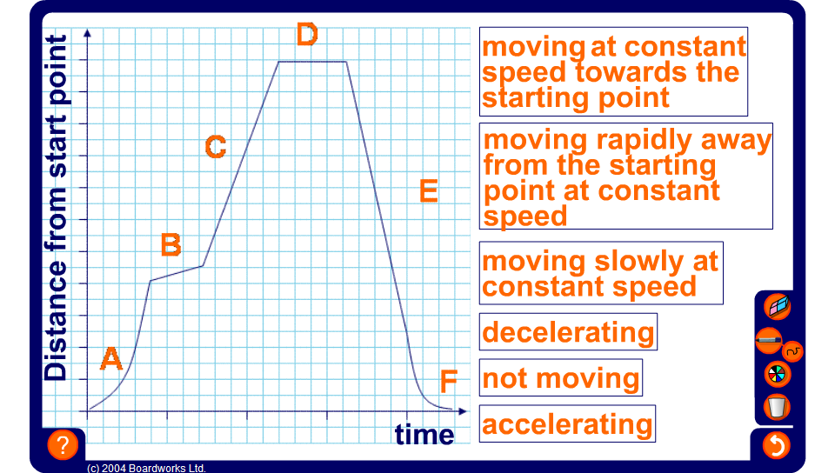


Label the distance-time graph
Notes:
Use this activity to discuss the meaning of different parts of the graph.
The correct positions are:
A, accelerating;
B, moving slowly at constant speed;
C, moving rapidly away from the starting point at constant speed;
D, not moving;
E, moving at constant speed towards the starting point;
F, decelerating.

